Slide 1

Review draft · 15 October 2026
BK8 × M3TA MEDIA
A CLEARER ROUTE
FROM SOCIAL
TO PLAYER.
Start with a consistent identity and an X programme built around BK8’s priority audience. Establish the baseline, test the content, then add channels where the evidence supports them.
Explore the full navigable proposal
M3TA MEDIA / BK8
Contents
Web proposal
01 / 10
Notes:
Source: supplied BK8 October 2026 proposal and Alexei’s instructions, 15 October 2026. Recommendation is proposed strategy. Website remains a review draft.

Slide 2
Review draft · 15 October 2026
ONE CONNECTED GROWTH PROGRAMME
01
Give the feed a recognisable identity
Build a small set of repeatable formats around BK8’s approved brand assets. Match-day posts, product stories and community prompts should feel connected while giving each format a clear job.
02
Give attention somewhere useful to go
Connect each campaign to the right product page or community destination. Use tagged links and agreed events so that visits can be followed beyond the social platform.
03
Expand from evidence
Prioritise the target market and strongest channel first. Introduce short-form video or a managed community when the audience, approvals and operational support are in place.
Jump to: Work / Plan / Investment / Team
M3TA MEDIA / BK8
Contents
Web proposal
02 / 10
Notes:
Discovery hypotheses, not verified claims about missing BK8 accounts or activity. Internal links are added to the final package. See content.json for full wording.

Slide 3
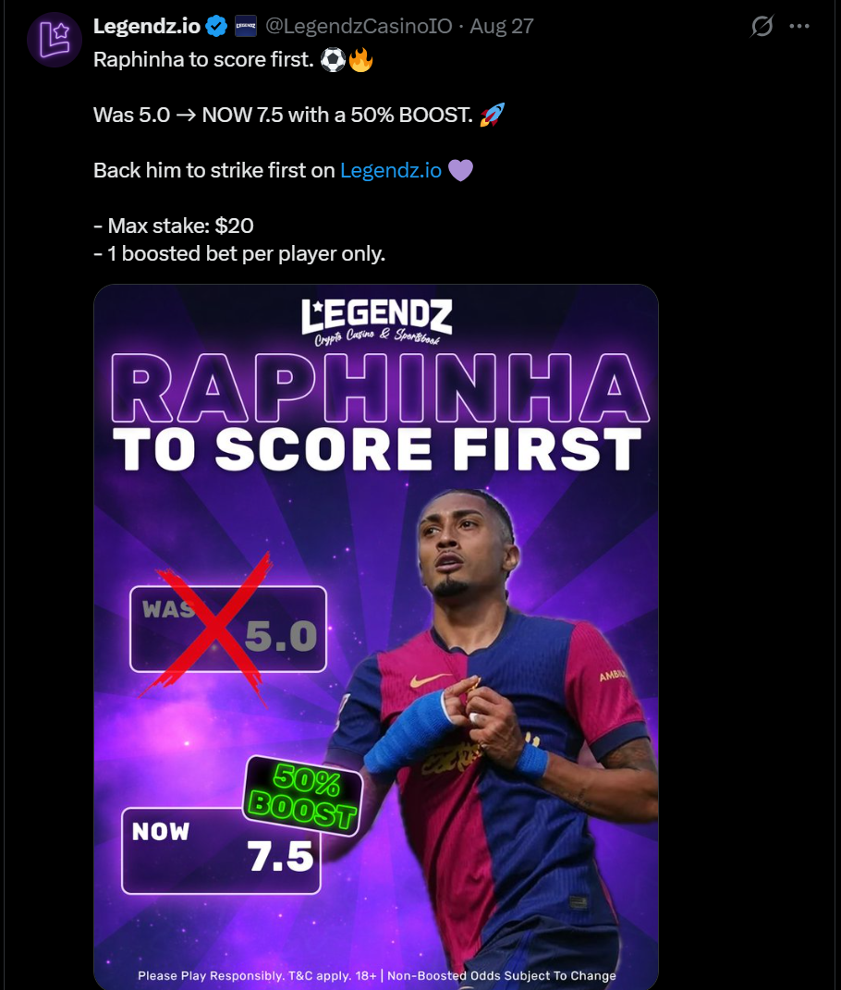
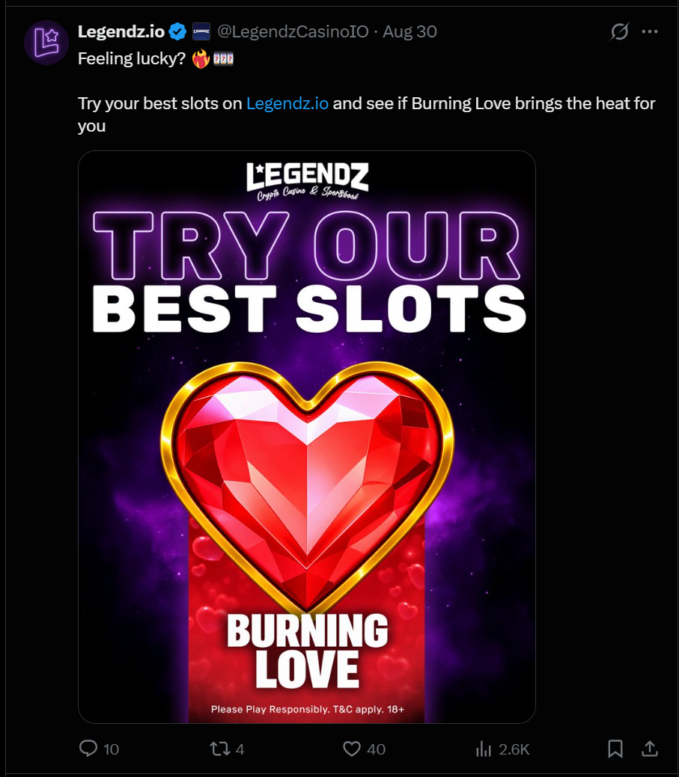
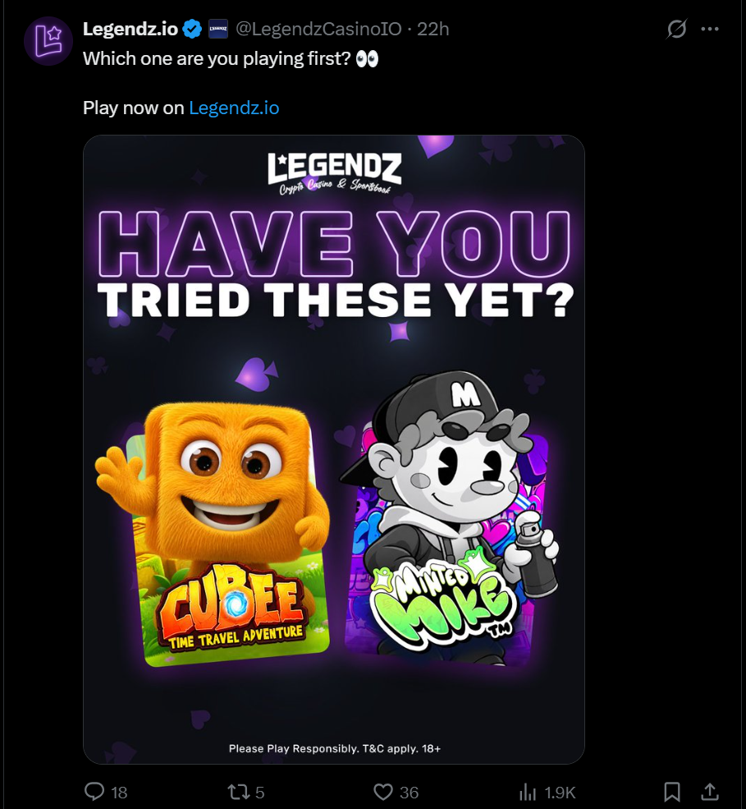
Review draft · 15 October 2026
RELEVANT WORK, MADE TANGIBLE
Sport and promotional creative
Casino product discovery
Community conversation
27 August 2026 · Legendz.io X
30 August 2026 · Legendz.io X
31 August 2026 · Legendz.io X
M3TA MEDIA / BK8
Contents
Web proposal
03 / 10
Notes:
Sources: historical first-party Legendz.io X captures, 27, 30 and 31 August 2026. Original media preserved. Historical offers are not current promotions or BK8 offers. Execution examples, not performance ranking.

Slide 4

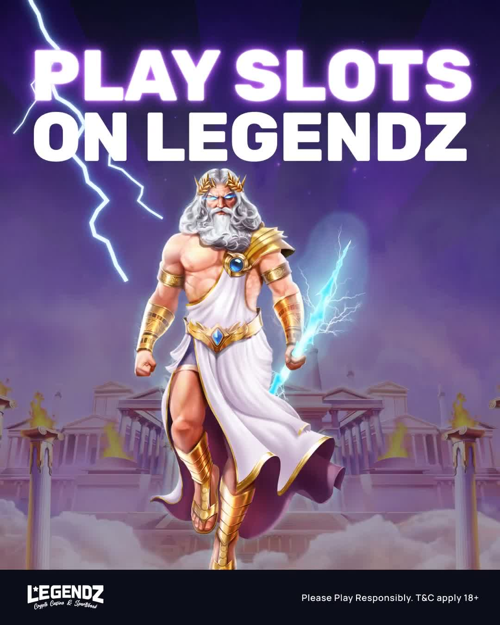
Review draft · 15 October 2026
MOTION THAT CARRIES THE BRAND
Selected production examples
Short game showcases from the Legendz.io creative library. Each treatment keeps the product and the brand visible.
For BK8: adapt the approach using BK8’s brand pack and approved product material.
Play the examples in the web proposal
M3TA MEDIA / BK8
Contents
Web proposal
04 / 10
Notes:
Sources: Sugar Rush v05 (12 October 2026), Gates of Olympus lightning v02 (9 October 2026). Production examples. Publication and performance are not asserted. Video links open the navigable web gallery.

Slide 5
Review draft · 15 October 2026
THE STARTING SCOPE
Identity and creative system
Audience alignment, content pillars and reusable social formats.
X strategy and management
Daily publishing, platform-native copy, relevant replies and reporting.
Instagram and short-form video
Optional expansion. Production volumes and TikTok inclusion to agree.
Discord community operations
Optional expansion. Structure, moderation and an agreed event programme.
Before kickoff: agree production quantities, coverage, approvals and account access.
M3TA MEDIA / BK8
Contents
Web proposal
05 / 10
Notes:
Scope adapted from the supplied proposal. Identity and X are the recommended starting scope. See web #plan for dependencies. No fixed video quantities, coverage hours or staffing are committed before agreement.

Slide 6
Review draft · 15 October 2026
THE FIRST 90 DAYS
Days 1–30
Days 31–60
Days 61–90
Establish the foundation
Test the formats
Refine the programme
Confirm the audience, channels and scope. Audit the correct accounts, agree the creative direction, configure tracking and launch the first content calendar.
Compare content themes, creative treatments and calls to action. Review audience response alongside tracked traffic and any available registration data.
Put more effort into the strongest repeatable formats. Review the journey beyond the click and agree the next quarter’s scope from the observed results.
Baseline report, working templates and the first publishing cycle.
A format review and a decision on the next channel or campaign test.
A 90-day review, recommendations and the next-quarter plan.
M3TA MEDIA / BK8
Contents
Web proposal
06 / 10
Notes:
Proposed sequence, dependent on access, approved scope and feedback. Working rhythm: shared calendar, agreed approvals, weekly check-ins and monthly review. Targets follow baseline.

Slide 7
Review draft · 15 October 2026
FOLLOW THE JOURNEY BEYOND THE POST
Stage | What we measure | Evidence
Attention | Impressions, video views and audience growth | Native platform analytics
Engagement | Meaningful replies, shares and content engagement | Platform data and content review
Intent | Tagged link clicks and landing-page sessions | UTM links and BK8 web analytics
Acquisition | Registrations and first-time deposits, where attributable | BK8 conversion events and reporting access
Retention | Returning participation and community activity | Agreed product and community reporting
Registration and deposit attribution depend on BK8 event definitions, access and reporting. Agree the baseline and attribution window before setting targets.
M3TA MEDIA / BK8
Contents
Web proposal
07 / 10
Notes:
Proposed measurement framework. No acquisition or revenue result is claimed. Native social metrics and product conversion events are separate. Source: content.json measurement plan.

Slide 8
Review draft · 15 October 2026
INVESTMENT AND OPTIONAL ADDITIONS
Package | USD / month | Scope position
X strategy and management | $5,000 | Recommended start
Discord community management | $5,000 | Optional addition
Instagram / TikTok package | $3,500 | Optional addition
All 3 listed packages: $13,500/month before any agreed discount.
Rates are reproduced from Andy’s October 2026 proposal in USD per month. The original lists content at $0/month and a 5% discount for 3 or more channels. Included creative quantities, channel counting, discount eligibility, taxes, term and any setup fees need written confirmation before acceptance. Creator fees, paid media, prizes and partner services require a separate agreed budget.
M3TA MEDIA / BK8
Contents
Web proposal
08 / 10
Notes:
Source: supplied BK8 proposal, slide 17, October 2026. Listed rates reproduced, not newly approved terms. Original $0 content row and 5% discount require clarification. TikTok label and description differ. $13,500 is arithmetic subtotal of $5,000 + $5,000 + $3,500, before any agreed discount.

Slide 9
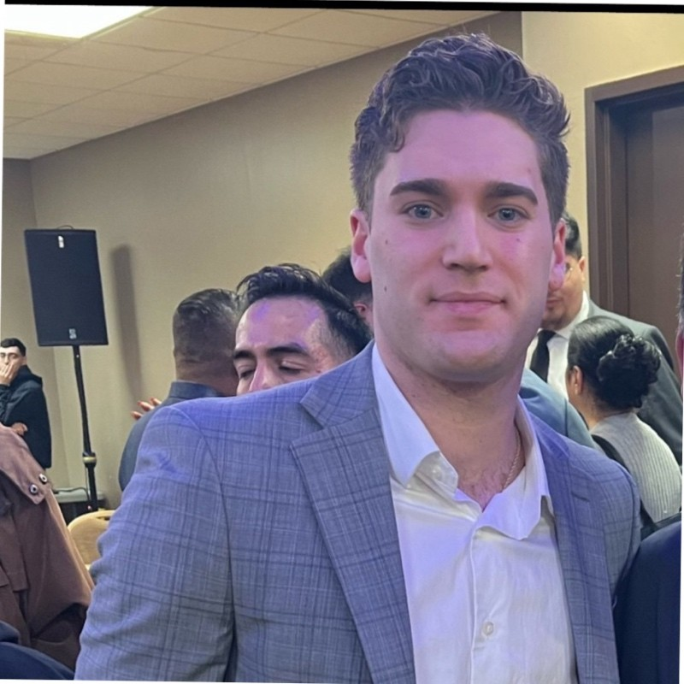

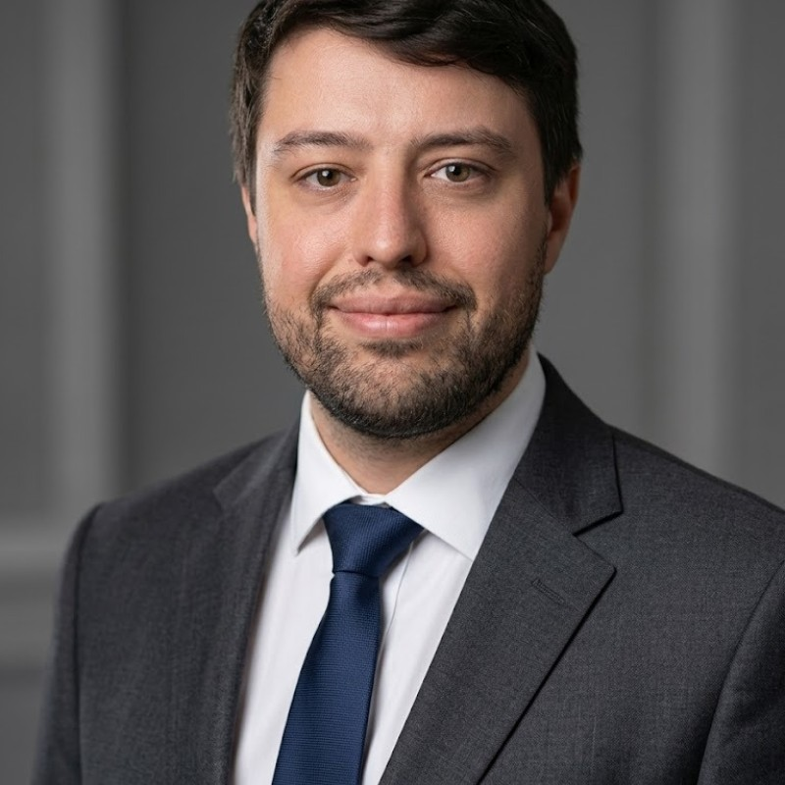

Review draft · 15 October 2026
THE PEOPLE BEHIND THE WORK
Alec Ramirez
Andy Keelaghan
Alexei Udall
Founder & CEO
Head of Sales and Partnerships
Head of Growth
LinkedIn
LinkedIn
LinkedIn
M3TA MEDIA / BK8
Contents
Web proposal
09 / 10
Notes:
Team photos from the supplied source deck. Titles and LinkedIn destinations set by Alexei’s explicit instructions, 15 October 2026. Andy: Head of Sales and Partnerships. Alexei: Head of Growth.

Slide 10
Review draft · 15 October 2026
AGREE THE SCOPE. BUILD THE FIRST CYCLE.
01
Priority market, audience and BK8 product surface
02
Starting channels and the monthly production schedule
03
Final commercial scope, term and separate campaign budgets
04
Brand assets, account access and approval owner
05
Tracking access, baseline and measurable targets
Discuss the proposal
Open the full web proposal
alec@m3tamedia.io
M3TA MEDIA / BK8
Contents
Web proposal
10 / 10
Notes:
This is a review proposal, not a signed service agreement. Final scope, prices and terms require written agreement. Contact address from supplied source deck.

